Slide 1
Who Knew?
The truth behind student mobility and transition
JAM 2018
Pinnacle Harbourfront, Vancouver
Anna Tikina
and
Robert Adamoski

Slide 2
Let’s play:
Find the Plickers card for your table. It resembles this:
This is your table number
To choose answer “A”,
hold your card with “A”
at the top.

Slide 3
Let’s play:
We will be testing your knowledge regarding student transitions, mobility, access, and some other areas.
Your table will discuss, and choose one answer within 60 seconds.
We will scan your answer to record it.
Some of you will demonstrate your mastery of student transitions and mobility!

Slide 4
Let’s play:
One person at each table should head to Kahoot.it and enter the game PIN.
Your table will indicate one answer – The quicker you answer correctly, the most points.
Some of you will demonstrate your mastery of student transitions and mobility!

Slide 5

Is it true that the BC Transfer System is like transfer in California.
“British Columbia has taken the California model and developed it into possibly the most extensive credit accumulation and transfer arrangement in the world.”
Bekhradnia, Higher Education Policy Institute, UK

Slide 6
 | California Tripartite System | BC Transfer System
Research Universities | UC 9 campuses | 6 universities
Teaching Universities | SCU 23 campuses | 10 (incl. 4 privates; 1 non-BC)
Colleges and institutes | CCC 122 campuses | 21 (incl. 7 private; 1 non-BC)
Colleges and institutes - Degree granting | 12% (15 programs in 2017/ 18) | 76% (16; incl. 1 private; 88 programs)
Population (July 2015) | 39.1 million | 4.7 million
Transfer enrolled at RIU (average 2008-2013) | 19% | 34%
Notes:
Difference: BC institutional autonomy
CA: # of AD programs at CCC
BC: # of baccalaureate programs at Colleges and Institutes
BC: # of certificates and diplomas at TIUs.
CA: UC – Accountability Report 2016; CSU – Performance Measure Report 2016;
Degree granting CCC: http://californiacommunitycolleges.cccco.edu/Portals/0/DocDownloads/PressReleases/JAN2015/PR_4yrDegree-January-20-2015_final.pdf
CCC: 15 bachelors programs approved in 2015
BC: RIUs – Transfer Student Profile Report 2015; TIUs – STP; Colleges – STP;
Colleges and Institutes offer 88 baccalaureate programs

Slide 7
Over 54,000 students annually moved from one BC public post-secondary institution to another in 2015/16. Was this a record high number?
Yes
No

Slide 8
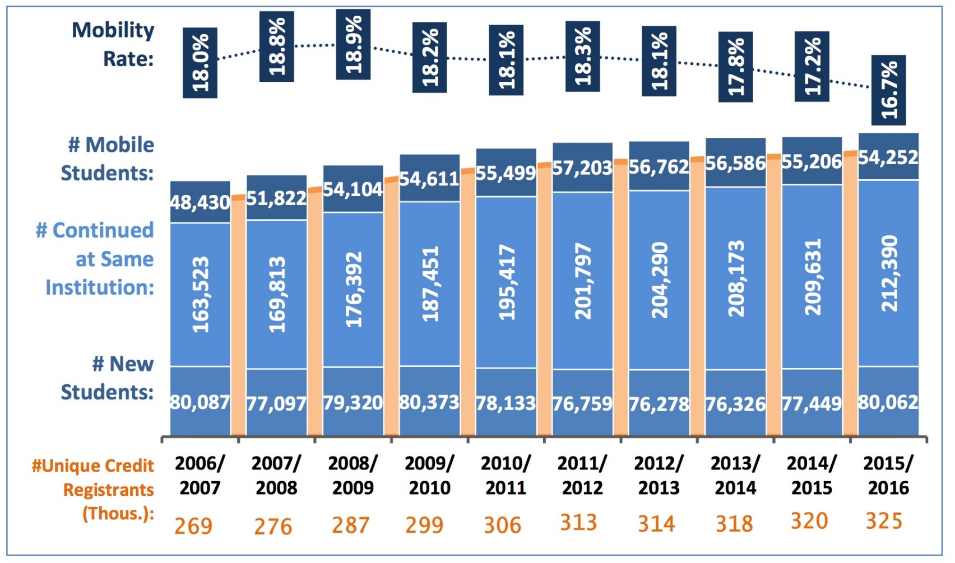
B) No

Slide 9
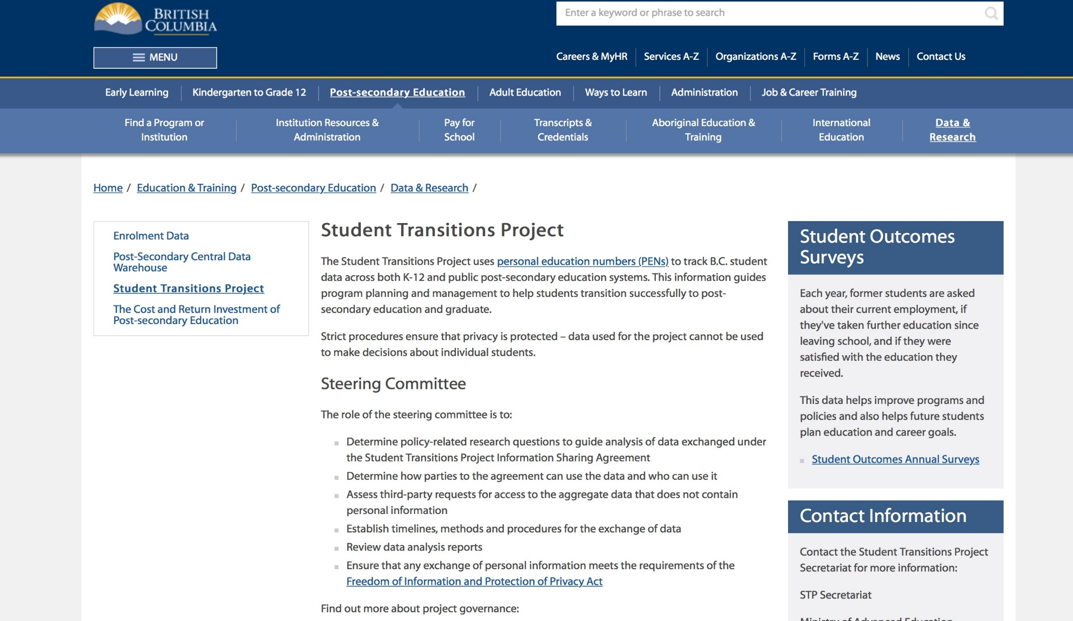
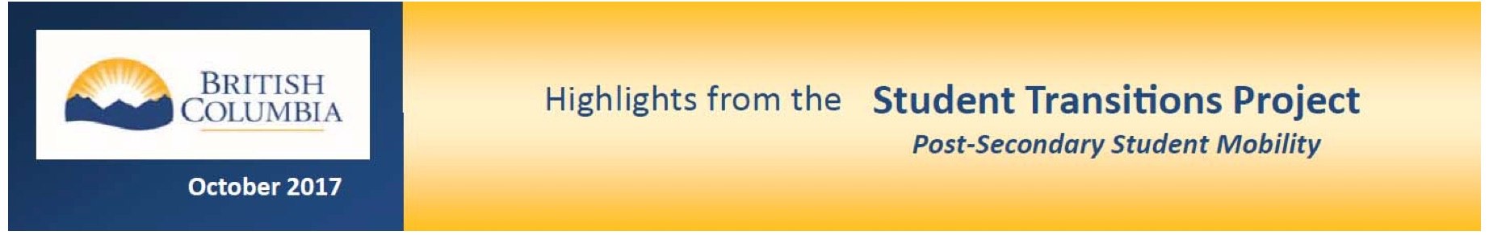

Slide 10
45% of BC baccalaureate degree completers attend more than one institution to complete their degree.
Is it true that only three US states had rates this high?
A) Yes
B) No

Slide 11
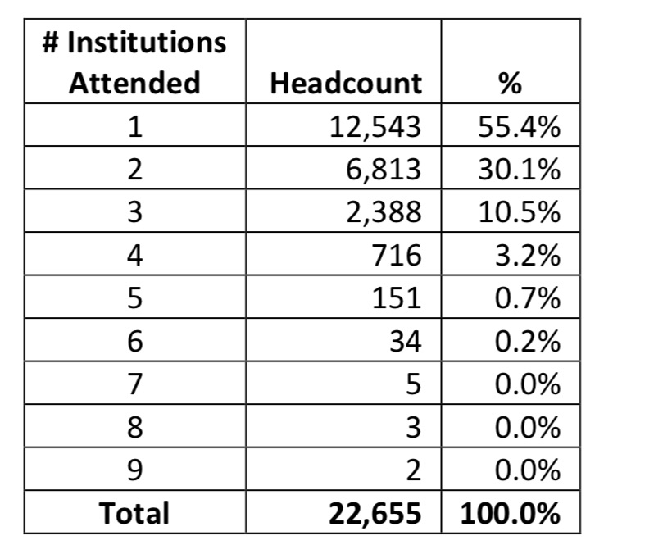
45%

Slide 12
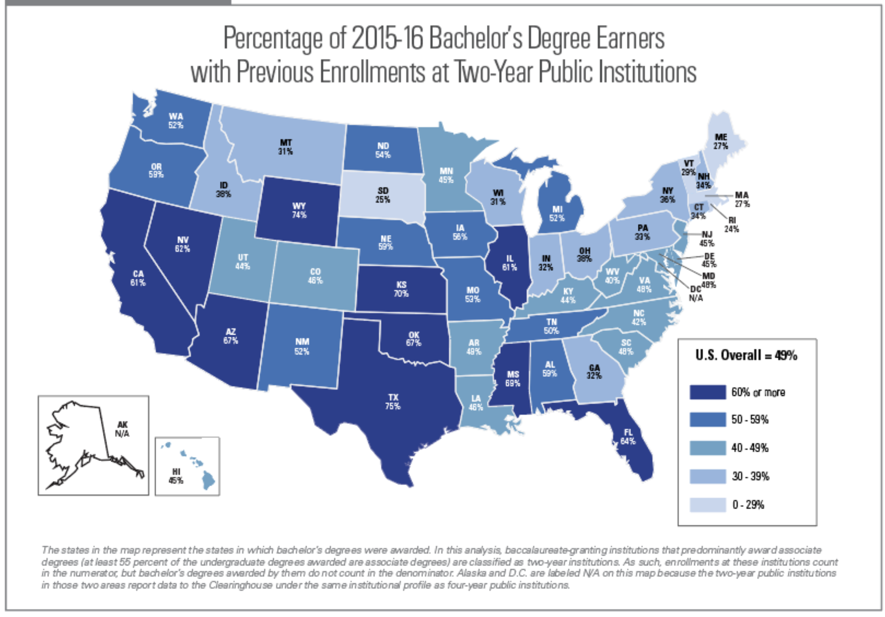

Slide 13
45% of BC baccalaureate degree completers attend more than one institution to complete their degree.
Is it true that only three US states had rates this high? B) No – 24 states had 45% or higher.

Slide 14
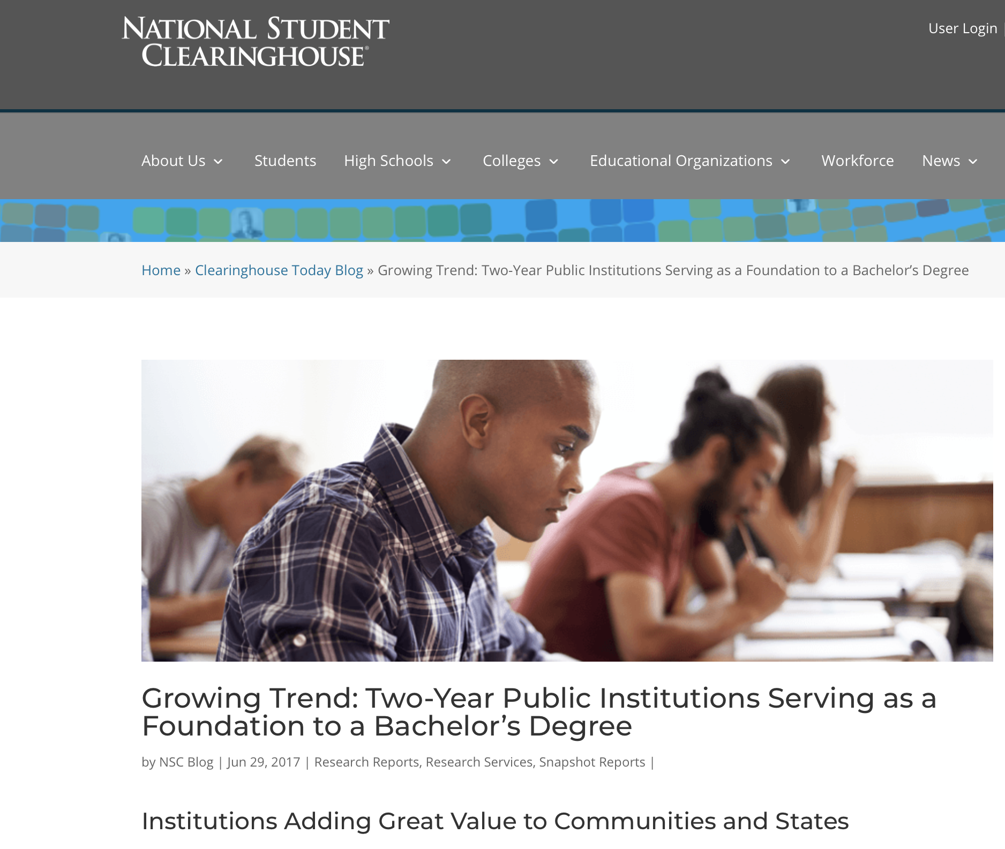

Slide 15
Is it true that more than half of dual credit students continue into post-secondary?
A) Yes
B) No

Slide 16
Transitioned to PSE
59%
A) Yes
Notes:
Haven’t returned 1471
To Camosun 1309
To other PSIs 803

Slide 17
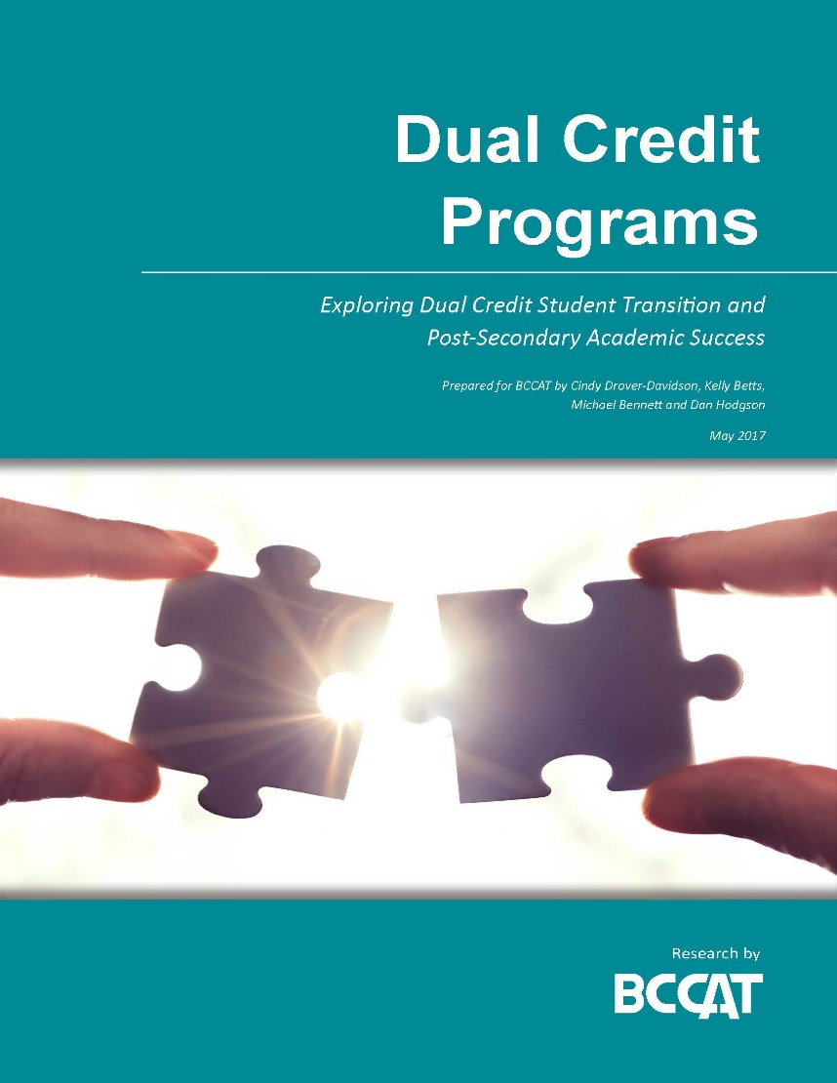
Dual Credit Programs: Exploring Dual Credit Student Transition and Post-Secondary Academic Success. May 2017.
(A case-study of South Island Partnership)
www.bccat.ca/Media/Default/pubs/dualcredit_may2017.pdf

Slide 18
What proportion of BC secondary school districts have high schools that offer Advanced Placement (AP) courses? a) 95% b) 65% c) 45% d) 25%

Slide 19
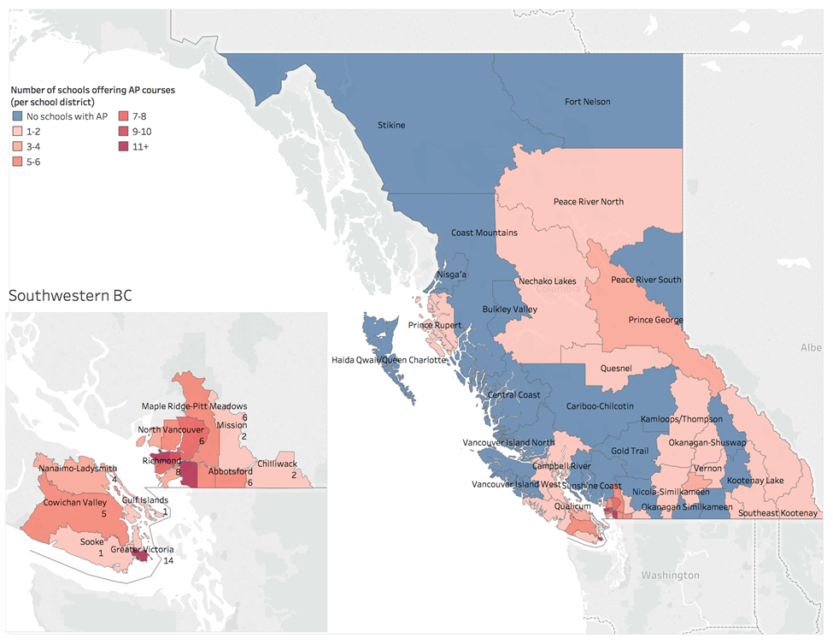
b) 65%
Notes:
Figure shows the geographic distribution of school districts offering AP courses. At the time of writing, a list of specific course offerings was not available provincially, but the College Board website listed schools that offered at least one AP course in BC. This information was mapped to school districts and administrative areas publicly available from BC Stats (1996, 2011). The maps show concentrations of schools offering AP located primarily, but not exclusively, in urban regions in BC.
A note of caution in using map based analysis: the colour coding may overemphasize school districts with multiple schools offering AP (such as a school district with 5 schools offering one AP course each versus a school district with one school offering 5 courses), and the geographic representation may overemphasize geographically large school districts regardless of enrolment.

Slide 20
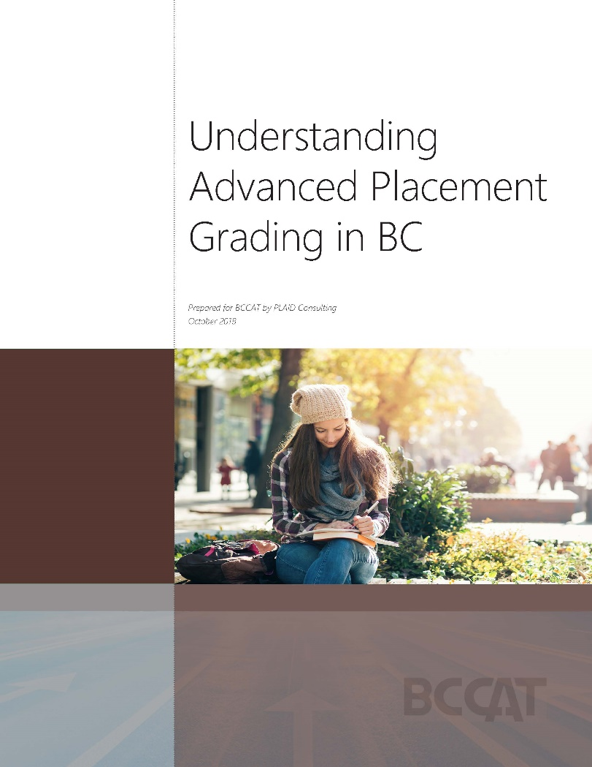
Understanding Advanced Placement Grading in BC. October 2018
http://www.bccat.ca/pubs/AP_Grading.pdf

Slide 21
The Mainland/ Southwest Region has the highest percentage of post-secondary students who did not graduate from high school. a) True b) False

Slide 22
B) False

Slide 23
The majority of non-graduates entering BC public post-secondary education are male.
A) True
B) False

Slide 24
B) False
51%
49%
Notes:
Non-Grads - Male 49%; Female 51%

Slide 25
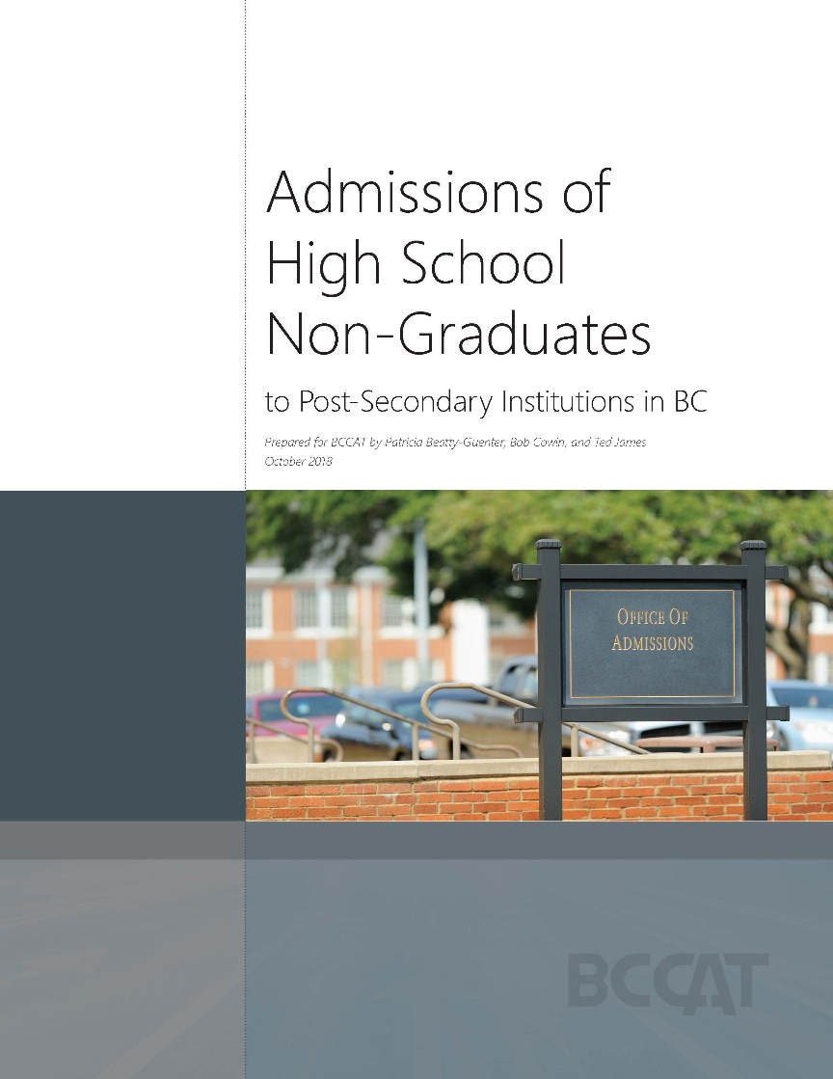
Admissions of High School Non-Graduates to Post-Secondary Institutions in BC. October 2018
http://www.bccat.ca/pubs/Non-Grads.pdf

Slide 26
Having a university-educated parent more than doubles the likelihood of going to university.
A) Yes
B) No

Slide 27
A) True
Derived from CCL (2009)
Notes:
Canadian Council on Learning (CCL) (2009). Post-secondary Education in Canada: Meeting our needs? Retrieved from https://files.eric.ed.gov/fulltext/ED525254.pdf .

Slide 28
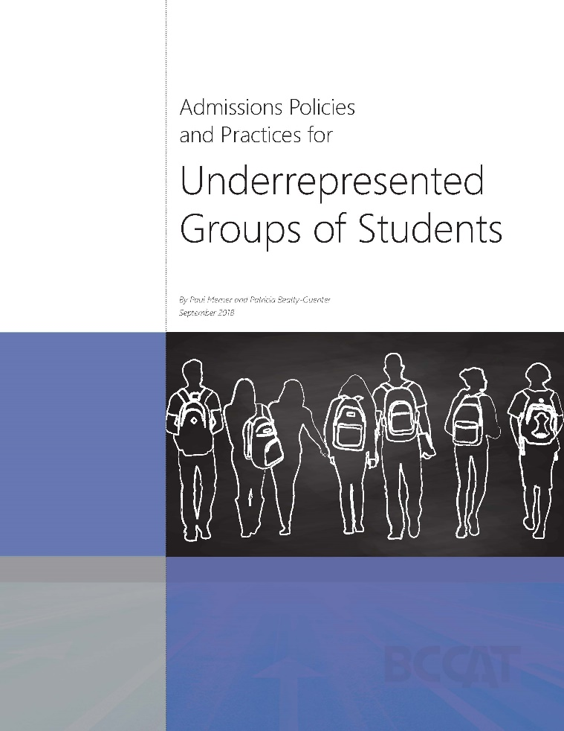
Admissions Policies and Practices for Underrepresented Groups of Students. September 2018.
http://www.bccat.ca/pubs/Underrepresented_Groups.pdf

Slide 29
Which of the following program areas ranks high for domestic student credit transfer, and low for credit transfer by international students?
A) Engineering & Applied Sciences
B) Trades
C) Health
D) Education

Slide 30
C) Health
Source: AEST, CDW Spring 2018
Notes:
Rank of program area (CIP Cluster) by the number of credits transferred to CDW institutions in AY 2016-17.

Slide 31
Which of the following lists includes student groups which all have above average mobility rates?
Female, non-indigenous, and international students
Female, indigenous, and domestic students
Male, indigenous, and domestic students
Male, non-indigenous, and international students

Slide 32
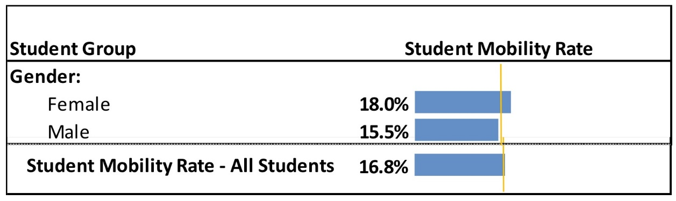
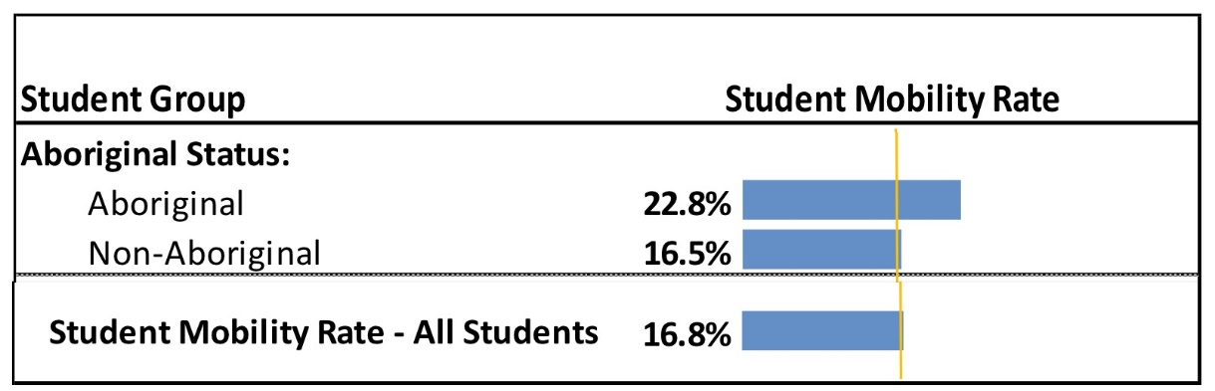
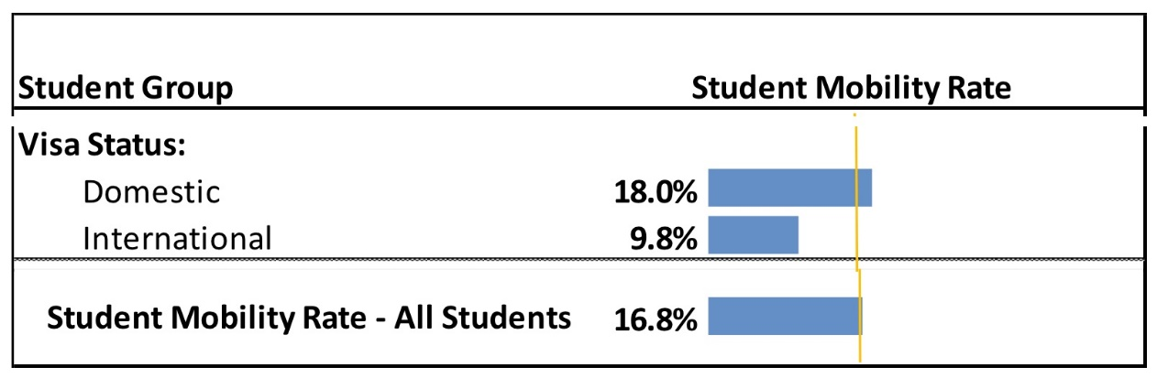
B) Female, indigenous, and domestic students

Slide 33
Lightning Round: Which groups have above average mobility rates?
Indigenous students
End
1
2
3
4
5
6
7
8
9
10
11
12
13
14
15
16
17
18
19
20

Slide 34

Lightning Round: Which groups have above average mobility rates?
Aboriginal students - True

Slide 35
Lightning Round: Which groups have above average mobility rates?
International students
End
1
2
3
4
5
6
7
8
9
10
11
12
13
14
15
16
17
18
19
20

Slide 36

Lightning Round: Which groups have above average mobility rates?
International students – Not true

Slide 37
What did we learn?
Over 54,000 BC students move over well over 400,000 credits annually. This is fairly consistent, with a recent reduction in the proportion of mobile students.
The rate at which students transition to post-secondary in BC varies regionally, and by several social, educational and individual characteristics.
BC’s Transfer System supports the progression of a number of under-represented student groups through the post-secondary system.

Slide 38
THANK YOU!
Anna Tikina atikina@bccat.ca
Robert Adamoski radamoski@bccat.ca

